Slide 1
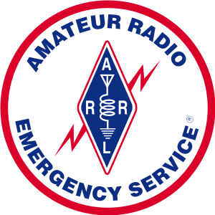
Kentucky District 3
Warren County
KCARC Meeting – 2026.09.22

Slide 2
Agenda
General Updates
Roll Up Dual Band Antenna
Radiogram Practice

Slide 3
General Updates

Slide 4
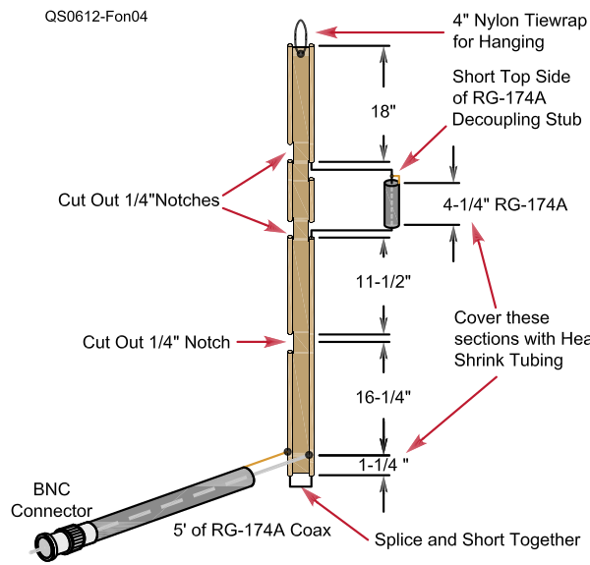
Dual Band Roll Up Antenna
Rubber Duckies often have negative dBi
Ed Fong WB6IQN Design
Replace 4-1/4” of RG-174A with 5” of RG8X with 5” cut in ladder line to match
A good chunk of shrink wrap (red box) over the Coax going to radio will secure it to the ladder line and join the stub and ladder line together

